Slide 1

The Technology Value Stream
Joel Atkinson
January 7, 2026
CSD380 DevOps

Slide 2
Introduction To The Technology Value Stream
What is the technology value stream?
The technology value stream is the start to finish process of transforming a business idea into deployed software.
What does it involve?
The technology Value Stream involves mapping all steps of the process necessary to turn the idea into deployed software. These steps often include things like ideation, development, testing, deployment, and monitoring. Having this plan creates a blueprint to allow the process to flow smoother and minimize errors or wasted time and resources.
What is the main goal?
The key focus is to accelerate the delivery of the product by planning ahead which minimizes activities and tasks that add no value to the project. This enables faster innovation and customer satisfaction which in turn creates better business outcomes such as higher revenue and market share.

Slide 3
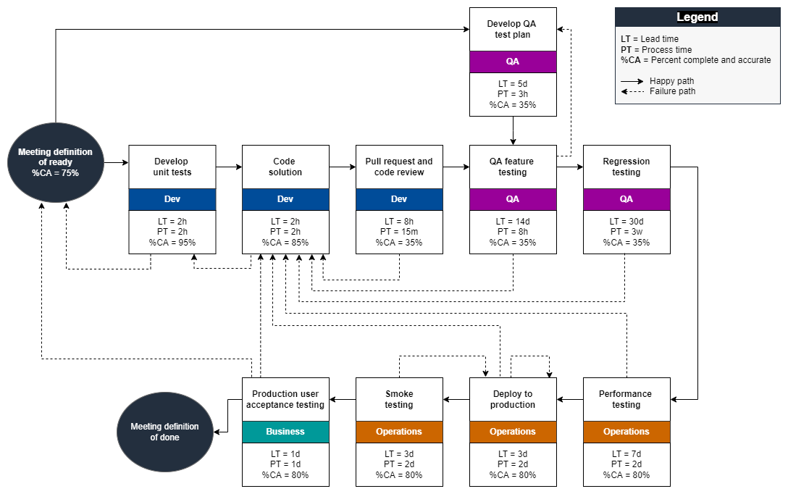
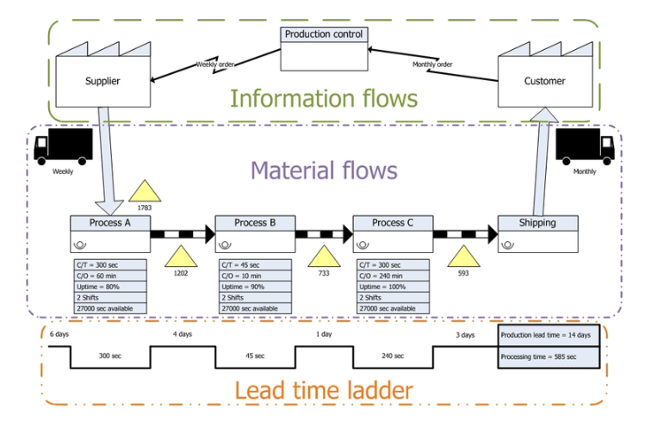
Examples of Value Stream Mapping
Value Stream Mapping is not a process only used in the tech world, it is also a common way for companies in a variety of lines of business to map out the process of going from the business idea to the delivery to the customer. Below are some examples of Value Stream Mapping for both tech as well as a generic example.
Example of Tech Value Stream Map
Retrieved from:
https://docs.aws.amazon.com/prescriptive-guidance/latest/strategy-devops-value-stream-mapping/introduction.html
Example of a Generic Value Stream Map
Retrieved from:
https://www.purdue.edu/leansixsigmaonline/blog/value-stream-mapping/

Slide 4
Defining Lead Time vs. Processing Time
What is Lead Time?
Lead time is the total elapsed time from when a customer request is received or an idea is initiated until the time that the product is delivered or deployed. This time includes everything involved in the product including wait time, handoffs, and other non-value adding time.
What is Processing Time?
Processing time is the actual time spent actively working on the project. This includes things such as coding, testing, reviewing, etc. This does not include wait time or non-value adding time.
Key Difference
Lead Time = Processing Time + Wait Time. In software DevOps, long Lead Times cause delays to feedback groups and the project overall whereas short Processing Times indicate efficient work.
Why Differentiate Them?
By separating the time spent on a project between Lead Time and Processing Time you are able to identify wasted or non-value time which in turn will allow you to address it and work on reducing it. By doing this, you will improve agility. For example, in value stream mapping, lead time might be weeks where processing time is only days. By differentiating the two you can plan better as well as work on reducing non-value time and lead time overall.

Slide 5
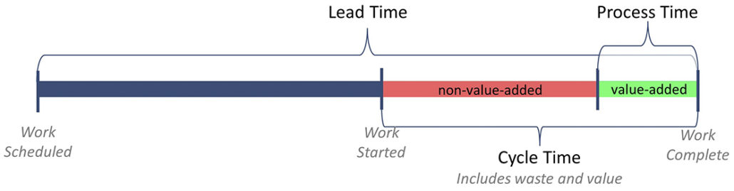
Lead Time vs Processing Time
This image simply outlines the difference between Lead Time and Process time and also shows “Cycle Time” which is time that does not include wait time but does include non-value time. This diagram is a simple and easy to understand timeline to show how the different types of time are categorized
Retrieved from: https://www.kaufmanglobal.com/glossary/lead-time/

Slide 6
The Common Scenario: Deployment Lead Times Requiring Months
In traditional (non-DevOps) IT environments, deployment lead times often span months due to things such as siloed teams, manual processes, and large batch releases. These are often found in large, complex organizations.
What Causes This?
This is caused by extensive manual testing, lengthy approval cycles, difficult integration from infrequent merges, and risk-averse deployments.
What are the Consequences of This?
Higher change failure rates, delayed processes and customer value, ”heroic” lengthy fixes required for everything, infrequent deployments, competitive disadvantages.

Slide 7
The DevOps Ideal: Deployment Lead Times of Minutes
Through the DevOps ideal lead times are achieved within minutes through checking small code changes into the version control repository, automated and exploratory testing, and deploying to production as soon as possible. This allows for things to be rolled out much faster and for the developers to receive fast, constant feedback.
What Are the Benefits?
Frequent deployments (sometimes multiple per day), rapid feedback, and lower risk, faster recovery times.
How is This Achieved?
This is achieved mostly when the architecture is modular, well encapsulated, and loosely coupled which allows small teams to work with a lot of automated processes and achieve minimal errors that are easy to handle and fix.

Slide 8
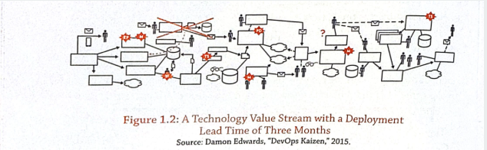
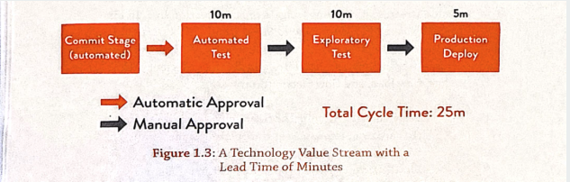
DevOps Ideal vs Common Scenario Value Streams
Figure 1: This is a value stream showing the complex nature of the common scenario. You can see just from the planning how this can cause major confusion and issues when done this way.
Figure 1: Retrieved from page 10 of the DevOps Handbook by Gene Kim
Figure 2: This is a value stream showing the how simple and easy the DevOps Ideal is. Just by comparing the two images you can see how much simpler and faster the DevOps ideal method is.
Figure 2: Retrieved from page 10 of the DevOps Handbook by Gene Kim

Slide 9
Common Scenario vs DevOps Ideal Comparison Chart
Aspect | Common Scenario (Months) | DevOps Ideal (Minutes)
Deployment Frequency | Monthly/Quarterly | Multiple per day
Lead Time | Weeks/Months (high waste) | <1 hour (efficient flow)
Risk & Failure | High (large batches) | Low (small changes)
Benefits | Slow feedback, high cost | Fast value, agility

Slide 10
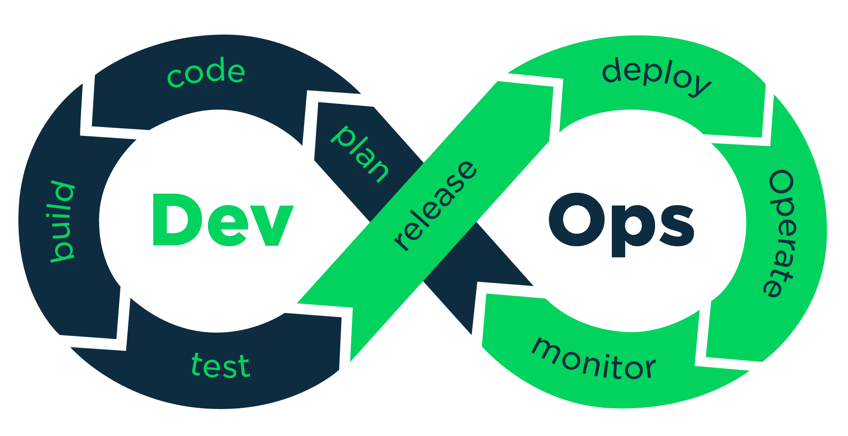
Conclusion
By mapping the Technology Value Stream to plan out the entire process from idea to deployment, and by adopting DevOps methods, development projects can be made much easier, less painful and greatly cut down on non-value time, reducing waste and enhancing performance to ensure that your product is delivered fast and effectively meeting customer expectations, staying within budget, and keeping the company competitive.
Image retrieved from:
https://devopedia.org/devops

Slide 11
Sources
Devopedia. (2022, February 15). DevOps. https://devopedia.org/devops
Kingery, M. (2023, April). Using development value stream mapping to identify constraints to DevOps outcomes. AWS Prescriptive Guidance. https://docs.aws.amazon.com/prescriptive-guidance/latest/strategy-devops-value-stream-mapping/introduction.html
Purdue University. (2024, November 7). Value stream mapping: The search for adding value and eliminating waste. Purdue Lean Six Sigma Online. https://www.purdue.edu/leansixsigmaonline/blog/value-stream-mapping/
Kaufman Global. (2017, October 1). Lead time. https://www.kaufmanglobal.com/glossary/lead-time/
Kim, G., Humble, J., Debois, P., & Willis, J. (2021). The DevOps handbook: How to create world-class agility, reliability, & security in technology organizations (2nd ed.). IT Revolution Press. (Chapters 1-4)
Bruneaux, T. (2025, October 30). Value stream mapping: A complete guide for software engineering teams. DX. https://getdx.com/blog/value-stream-analysis/

